Slide 1
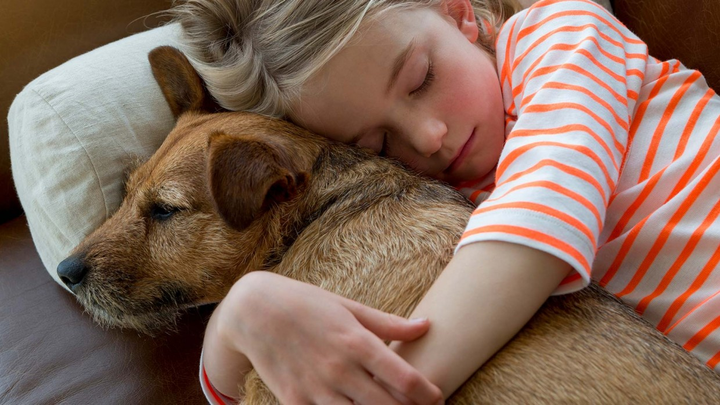
Mission: Match-A-Pet
Team: Deus Ex-Machina (God of Tech)
Benjamin Teo (bt839)
Gururaj Shinde (gss399)
Peter Geras (psg2)
Shruti Agarwal (sa5659l)
Sean Hornbuckle (sh4986)
Sprint Demo:
Registration Epic

Slide 2
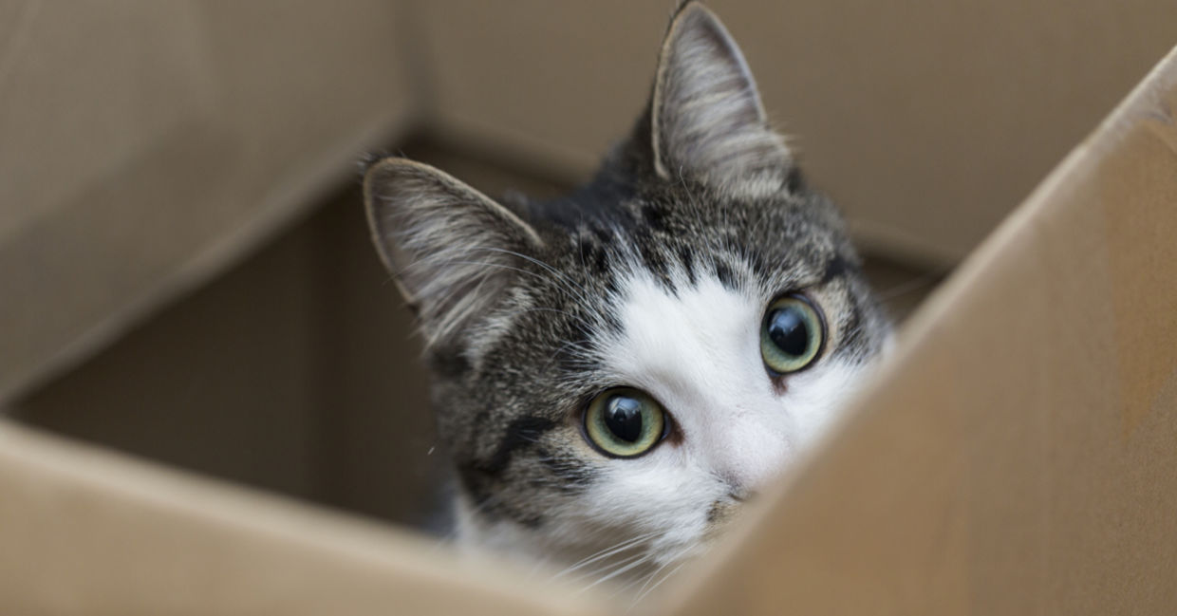
Context Diagram
Access User Profile
Post Pet Stories
Shelter staff + Volunteers
Notification + Action Board
Upload Pet Profile
Register
User
Connect with shelter staff
Engage in site’s social media
Connect with other local pet owners
Administrator
Login Management
Monitor Content
Manage Animal, Shelter & User Database

Slide 3
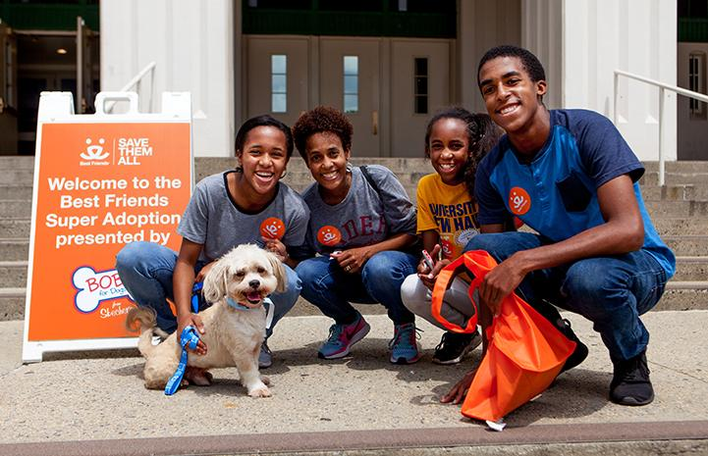
Registration Epic
User Stories:
As a Shelter employee I should be able to register on the site with reference to my concerned shelter
As a site visitor, I should be able to create an account on the website which will help me get a personalized feed and alerts
Notes:
A centralized portal that provides information on animals available for adoption in all shelters in a particular region, while prioritizing adoption of senior animals, those whose euthanization dates are near and those who have been in the shelter for too long.
Platform is to be accompanied by a portal for the Shelter staff and volunteers with a highly simple UI that will make it easy for them to update animal profile and make regular posts.

Slide 4
Registration Epic
Acceptance Criteria:
If users wants to use their Google or Twitter accounts to sign up, then they should be allowed to do so.
Users should have unique usernames
Users should be allowed to enter additional (but optional) details such as Profile Picture, Address, Interests, Willingness to adopt etc.
Shelter Staff registering on the website must be be able to select the Shelter they are associated with
Shelter details should be automatically filled if a shelter from the provided list is selected.
Both Users and Shelter Staff should get a verification mail with a verification link to confirm registration.
Clicking on the verification link in the verification mail should open the login page in a new tab
Notes:
A centralized portal that provides information on animals available for adoption in all shelters in a particular region, while prioritizing adoption of senior animals, those whose euthanization dates are near and those who have been in the shelter for too long.
Platform is to be accompanied by a portal for the Shelter staff and volunteers with a highly simple UI that will make it easy for them to update animal profile and make regular posts.

Slide 5
Registration Epic
Definition of Done:
Unit testing for all methods is done
All parts needed for the acceptance criteria are functional.
A short survey for the interface is done (at least 4 people outside the team), inputs taken, reviewed and incorporated
Epic is completed by expected deadline
Notes:
A centralized portal that provides information on animals available for adoption in all shelters in a particular region, while prioritizing adoption of senior animals, those whose euthanization dates are near and those who have been in the shelter for too long.
Platform is to be accompanied by a portal for the Shelter staff and volunteers with a highly simple UI that will make it easy for them to update animal profile and make regular posts.

Slide 6
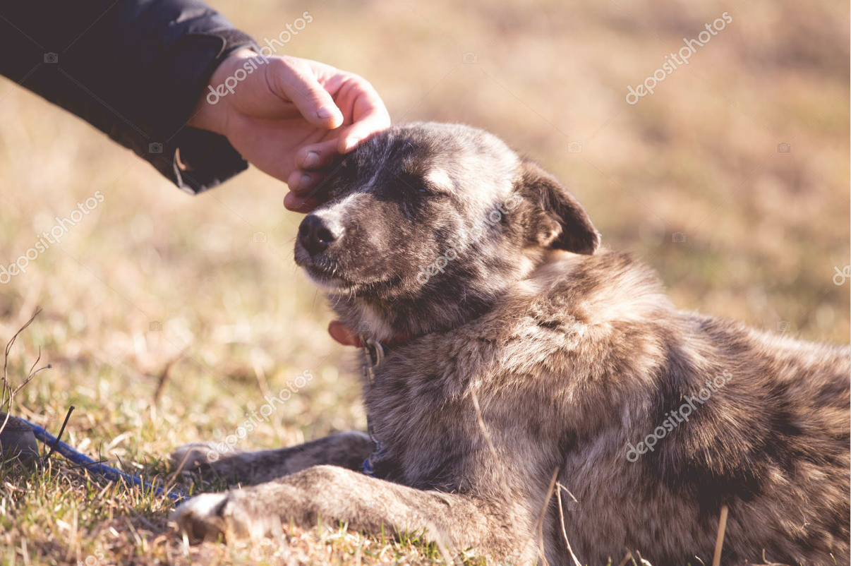
Shelter Staff/Volunteer Registration Activity Diagram
Home Page
Select ‘Register’
No
Are you Shelter Staff or Volunteer?
Redirect to User Registration Page
Yes
Enter Shelter Staff Registration form webpage
Dropdown menu appears on selecting shelter textbox
Yes
Is shelter listed?
No
Select shelter name from list
Select ‘Other’ from list and manually enter Name in previously greyed out text box
Form fields are automatically populated
Form fields are manually filled
Click on Save Shelter button, which will redirect user to login details page
Enter Username, Email, Password. (System will check for uniqueness)
No
Yes
Is username and email unique?
Send Verification Email
Yes
Email received?
Click on verification link.
User is redirected to login page

Slide 7
User Registration Activity Diagram
Home Page
Select ‘Register’
Yes
Are you Shelter Staff or Volunteer?
Redirect to Shelter Staff/Volunteer Registration Page
No
Enter User Registration form webpage
Enter Username, Email, Password. (System will check for uniqueness)
No
Is username and email unique?
Yes
Enter additional optional details such as Address, Profile Picture, Interested in adopting(Yes/No), Animals of Interest etc
Save Changes
Send Verification Email
Email received?
Click on verification link.
User is redirected to login page

